Slide 1
Golden Gate cloning system Monocots version (CRISPR/Cas)

Slide 2
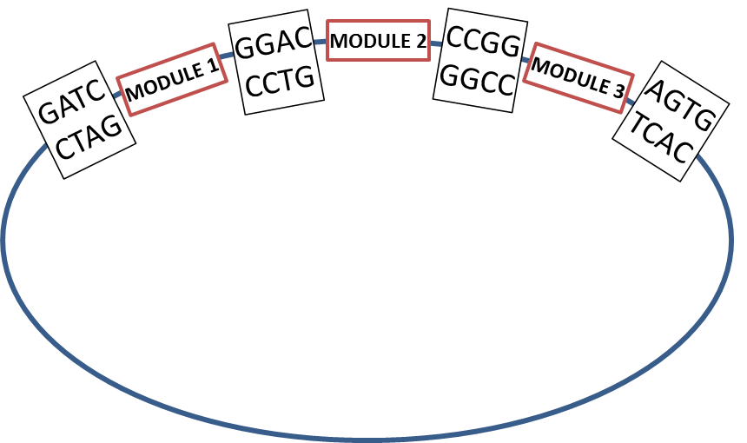
Entry module vectors
Module 1
pJG471: module 1 -> Ubi1::TaCas9 pMOD_A1110
pJG473: module 1 -> Ubi1::D10A nickase TaCas9
pJG499: module 1 -> Ubi1::H840A nickase TaCas9
Module 2
pJG310: module 2 -> TaU6:: (Esp3I cloning site) gRNA pMOD_B2518
Module 3
pJG338: module 3 -> TaU3:: (Esp3I cloning site) gRNA + BaeI site for cloning of a donor template by Gibson assembly
pJG340: module 3 -> TaU6:: (Esp3I cloning site) gRNA + BaeI site for cloning of a donor template by Gibson assembly pMOD_C2518
Destination vectors
pTC184: WDV destination vector (no resistant gene for plant regeneration; bacterial selection: Kan)
pRLG052: destination vector for particle bombardment (no resistant gene for plant regeneration; bacterial selection: Spec)
pTC278: destination vector that accepts Cas9 variant + Module 2 (plant selection: Hyg; bacterial selection: Kan)
pTC279: destination vector that accepts Cas9 variant + Module 2 (plant selection: Bar; bacterial selection: Kan)
pRLG103: destination vector that accepts Cas9 variant + Module 2 + Module 3 (plant selection: Hyg; bacterial selection: Kan)
pRLG105: destination vector that accepts Cas9 variant + Module 2 + Module 3 (plant selection: Bar; bacterial selection: Kan)
Final result

Slide 3
Cloning oligos into pJG310, pJG338, and pJG340
Target Sequence:
5’-ACGTACGTACGTACGTACGTAGG-3’
PAM is in RED
Note that normally, this first base in the target sequence is a G because of the PolIII promoter – if this is not a G, you can add an extra G in the oligos after the 4 base overhang (in blue here), or simply change the first base of the sgRNA to be a G and mismatch with the target
Underlined sequence + overhangs for cloning are ordered as oligos
Oligos for pJG310, pJG338, and pJG340
5’-ACTTGACGTACGTACGTACGTACGTG-3’
3’-CTGCATGCATGCATGCATGCACAAAA-5’
Bases in GREEN are the overhangs
Bases in ORANGE have to be added to the oligos since they are the first nt of the tracrRNA. (not true of pMOD_B and C2518

Slide 4
How to anneal and phosphorylate oligos (prior to cloning)
Phosphorylation of 5’ ends & hybridization and annealing
Mix: 1.5ul 100uM sense oligo
1.5ul 100uM anti-sense oligo
1.5ul 10xT4 ligase buffer
1ul T4 PNK (polynucleotide kinase)
9.5ul ddH2O
15ul total
Incubate at 37C for 1.5 hours
Add 2ul 0.5M NaCl
Place in boiling water bath for 2 min, then remove water bath from the heat source and allow the reaction ( still in the water bath) to cool to room temperature ( about 30C) (Notes – use the smallest amount of water you can get away with as it will decrease the time you need to start the boil and to cool the rxn to room temp. Cover beaker with foil (loosely!) while heating, but leave off during the cooling. Do not heat water with float in the bath. Use long tweezers to place float plus tubes into boiling water.)

Slide 5
Oligos cloning procedure
GoldenGate Reaction
1. Mix:
150 ng destination vector
2 μL 1:200 diluted oligos
1 μL Esp3I restriction enzyme
1 μL T4 ligase
2 μL 10x T4 DNA ligase buffer
water up to 20 μL
2. Put in a thermal cycler on the following program:
37°C for 10 minutes
16°C for 15 minutes
37°C for 15 minutes
80°C for 5 minutes
12°C for ever
3. Add 1 μL 25 mM ATP
1 μL Plasmid Safe enzyme
4. Put at 37°C for 1 hour.
5. Transform – plate on Carb (plus X-Gal/IPTG when the lacZ gene is used for selection)

Slide 6
Final Golden Gate rxn
GoldenGate Reaction
1. Mix:
150 ng destination vector
150 ng of each of the module vectors
1 μL AarI restriction enzyme
0.4uL AarI oligo (see product description)
1 μL T4 ligase
2 μL 10x T4 DNA ligase buffer
water up to 20 μL
2. Put in a thermal cycler on the following program:
37°C for 10 minutes
16°C for 15 minutes
37°C for 15 minutes
80°C for 5 minutes
12°C for ever
3. Add 1 μL 25 mM ATP
1 μL PlasmidSafe enzyme
4. Put at 37°C for 1 hour.
5. Transform – plate on Kan or Spec (plus X-Gal/IPTG when the lacZ gene is used for selection)

